Slide 1
19AIE101 ELEMENTS OF COMPUTING SYSTEMS-1
ASSIGNMENT-2

Slide 2
SUBMITED BY GROUP-11
1.
3.
VIKHYAT BANSAL [AIEA.1007359]
YARRAM SRI SATHWIK REDDY [AIEA.1038833]
2.
4.
VIGNESH.M
[AIEA.1008496]
MARREDDY MOHIT SASANK
REDDY [AIEA.1011669]

Slide 3
1
Design a half adder and a Full adder (with logic circuit for sum and carry). Implement the gate level logic of both the chips in HDL and test the chip in hardware simulator. (The chips and supporting files are available in project folder of nand2tetris software suite. Use script based simulation during presentation to show the results. Note that XOR implementation s required in prior).

Slide 4
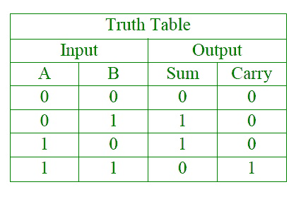
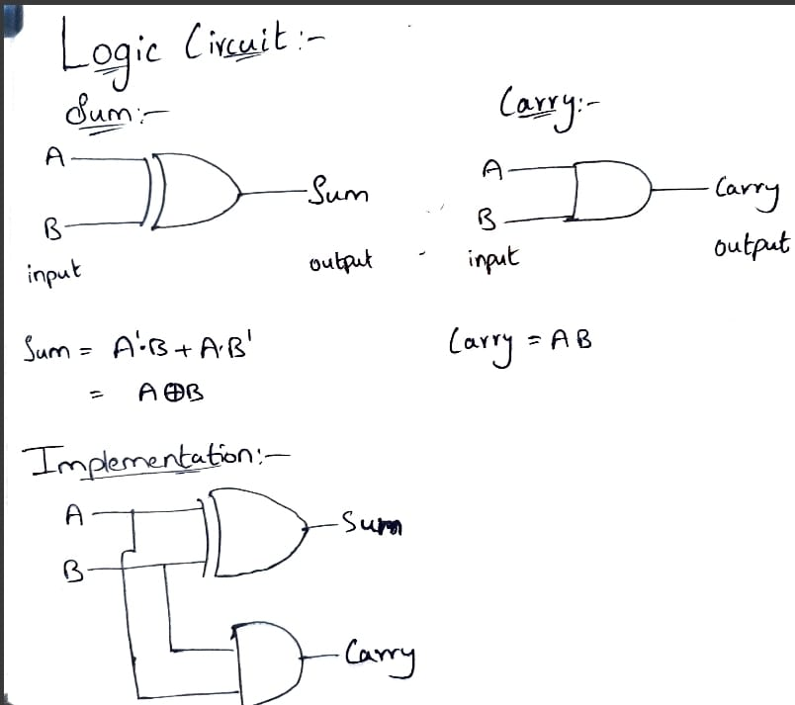
HALF ADDER:
DESIGNING A HALF ADDER WITH LOGIC CIRCUIT OF SUM AND CARRY:

Slide 5
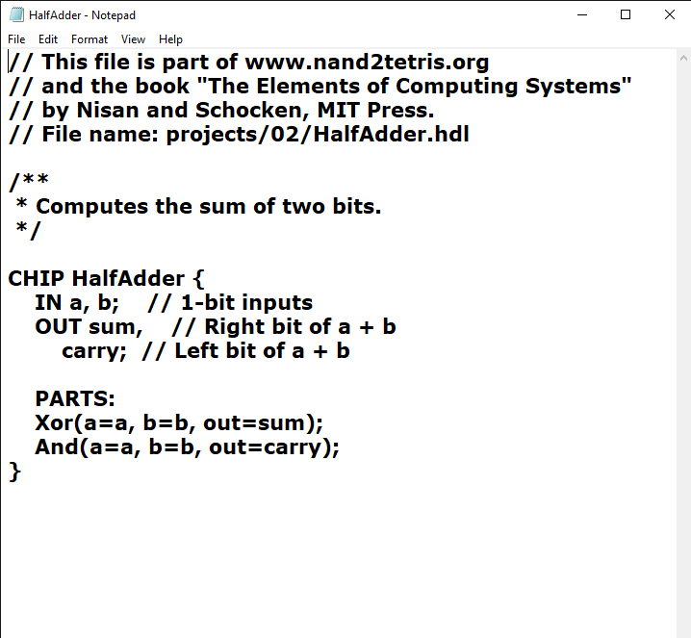
HDL FILE

Slide 6
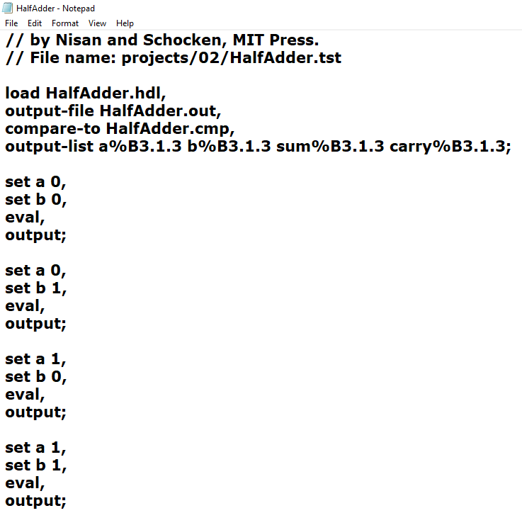
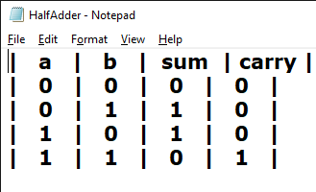
TEST FILE
COMPARE FILE

Slide 7
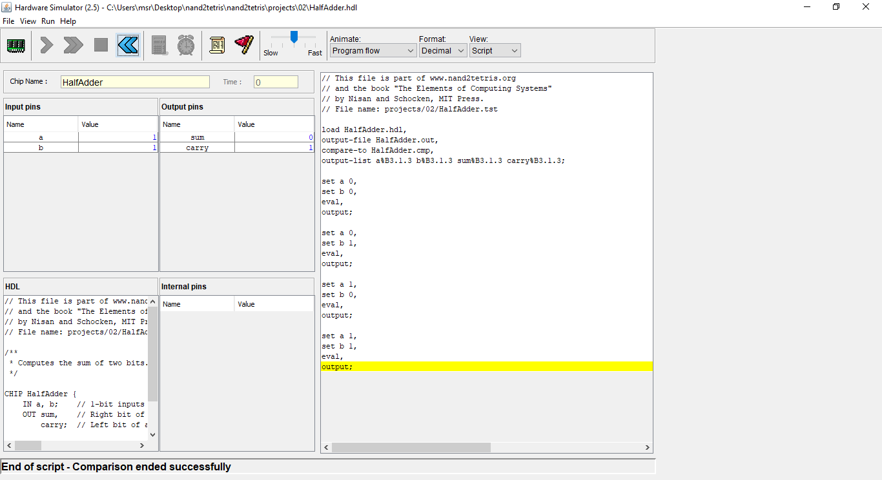
IMPLEMENTING THE CHIP LOGIC IN HARDWARE SIMULATOR:
NOW,let us run these files
In hardware simulator, test it, compare the output
Files.

Slide 8
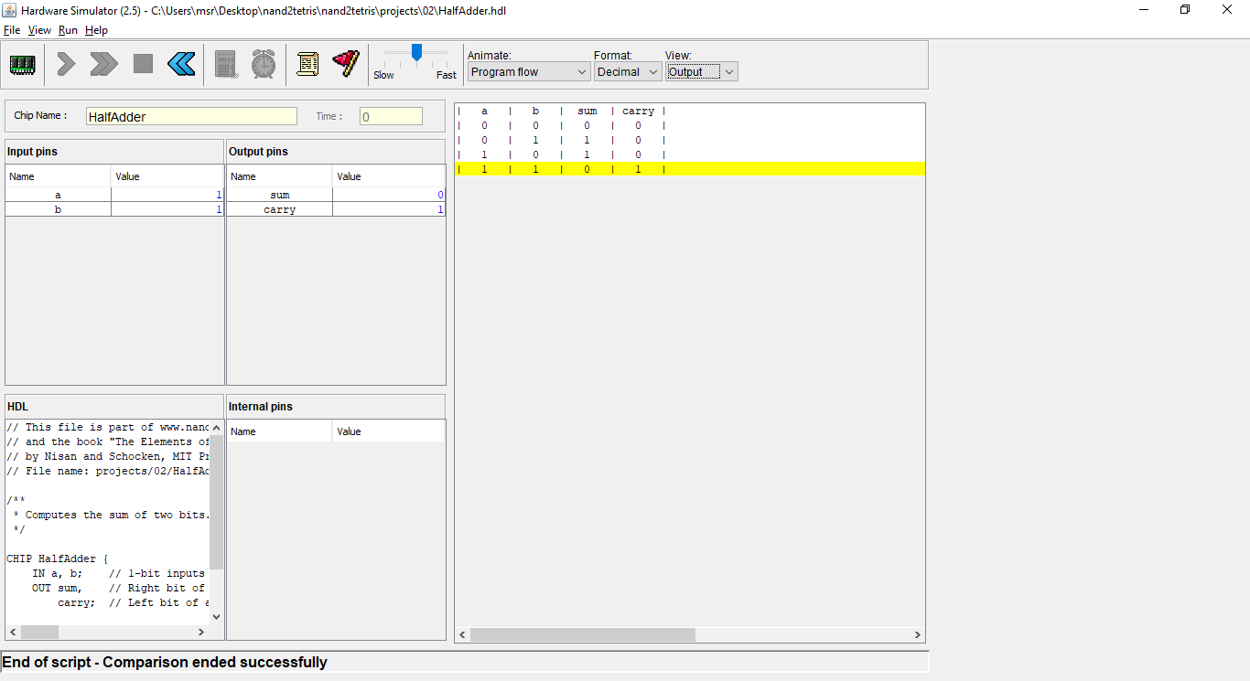
OUTPUT IN HARDWARE SIMULATOR:
NOW ,the truth table in the output in hardware simulator is
Similar to the truthtable in the first slide.

Slide 9
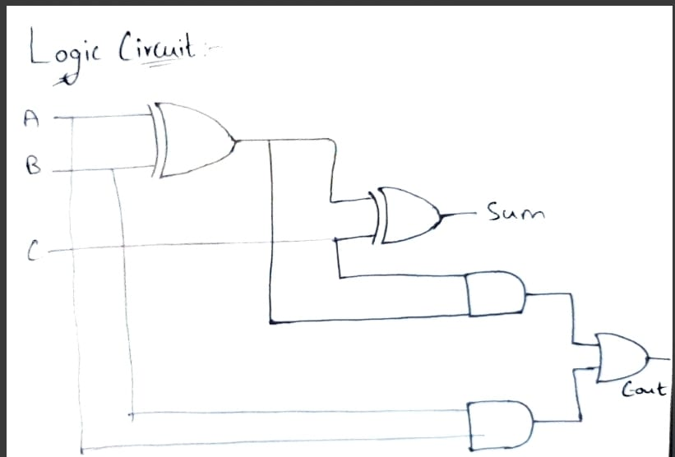
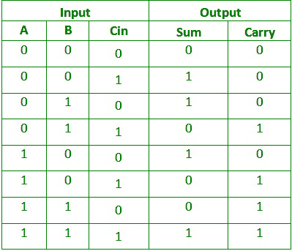
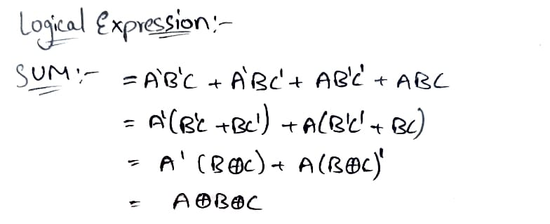
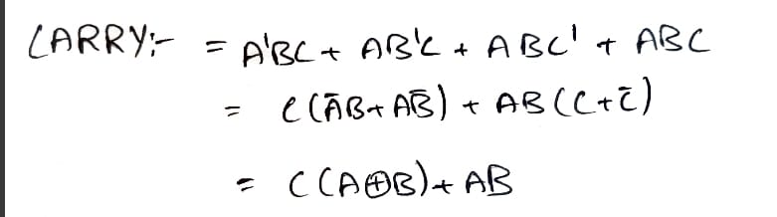
FULL ADDER:
DESIGNING A FULL ADDER LOGIC CIRCUIT FOR SUM AND CARRY:

Slide 10
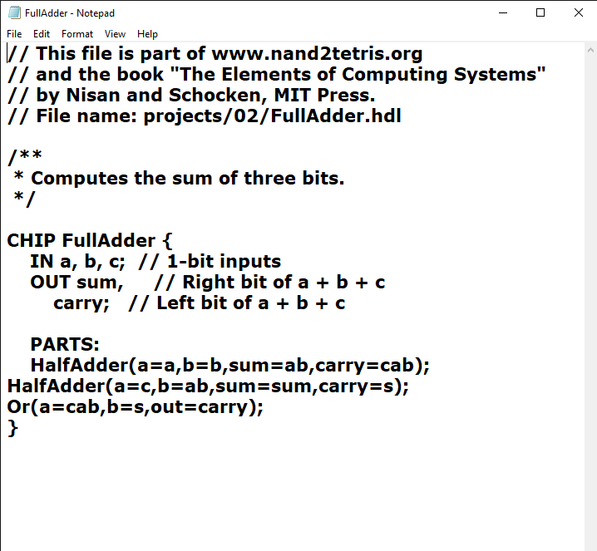
HDL FILE

Slide 11
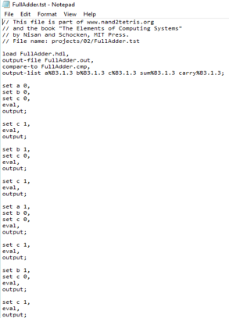
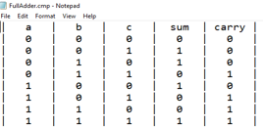
TEST FILE
COMPARE FILE

Slide 12
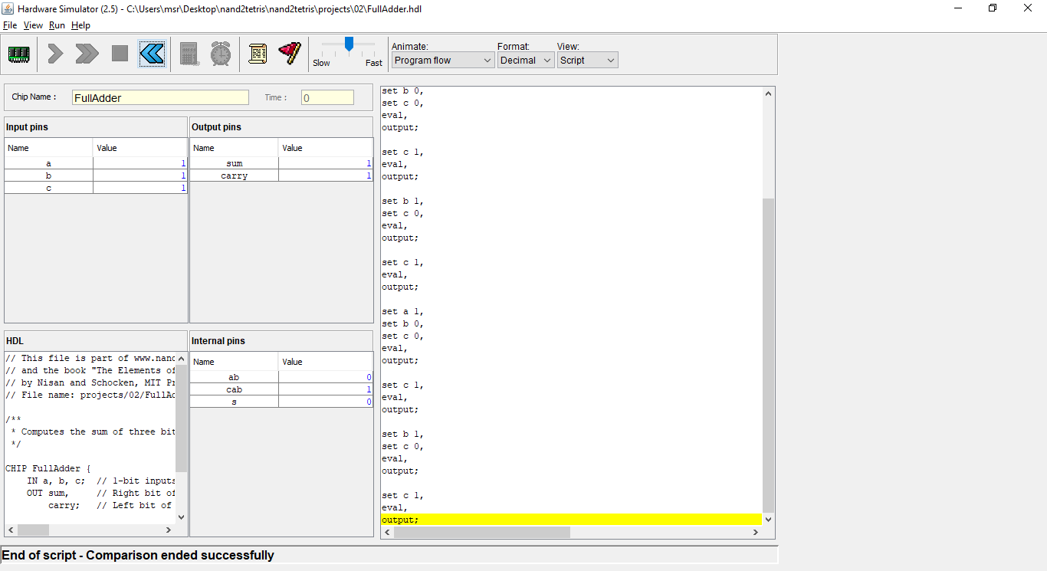
IMPLEMENTING THE CHIP LOGIC IN HARDWARE SIMULATOR:​
NOW,let us run these files
In hardware simulator,test
It and compare the output
Files.

Slide 13
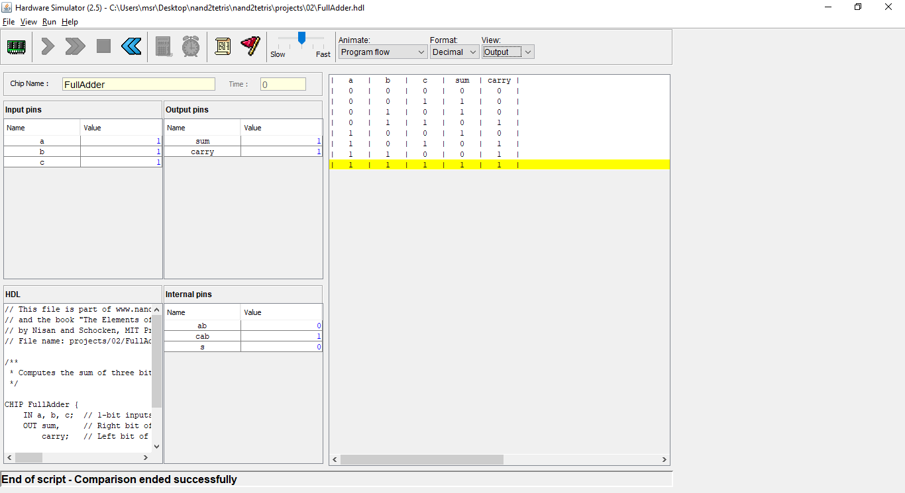
OUTPUT IN HARDWARE SIMULATOR:​
NOW ,the truth table in the output in hardware simulator is ​
Similar to the truthtable in the first slide.​

Slide 14
2
Design a Full adder using two half adders and an OR gate. Justify the gate level logic obtained for sum and carry function. Implement the designed logic in HDL using half adder chip constructed in Question 3 and test the chip in the hardware simulator. Give the CHIP name as “FA using HA”. (Use script based simulation (by creating script and cmp files) during presentation to show the results)

Slide 15
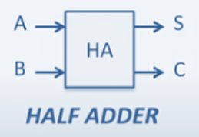
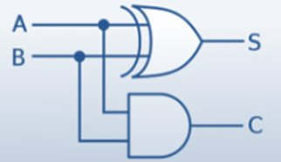
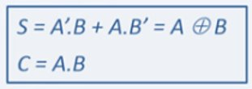
* Half Adder : Designed to add 2 bits
* FUll Adder: Designed to add 3 bits
Half Adder:

Slide 16
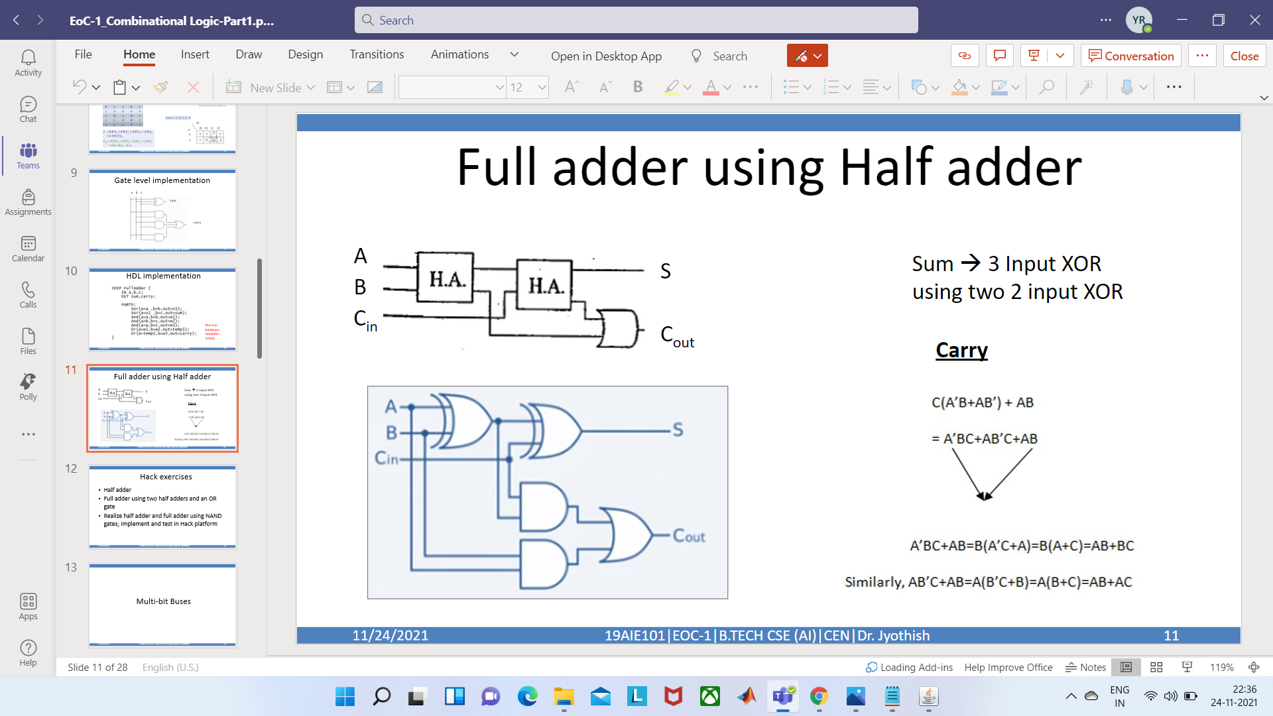
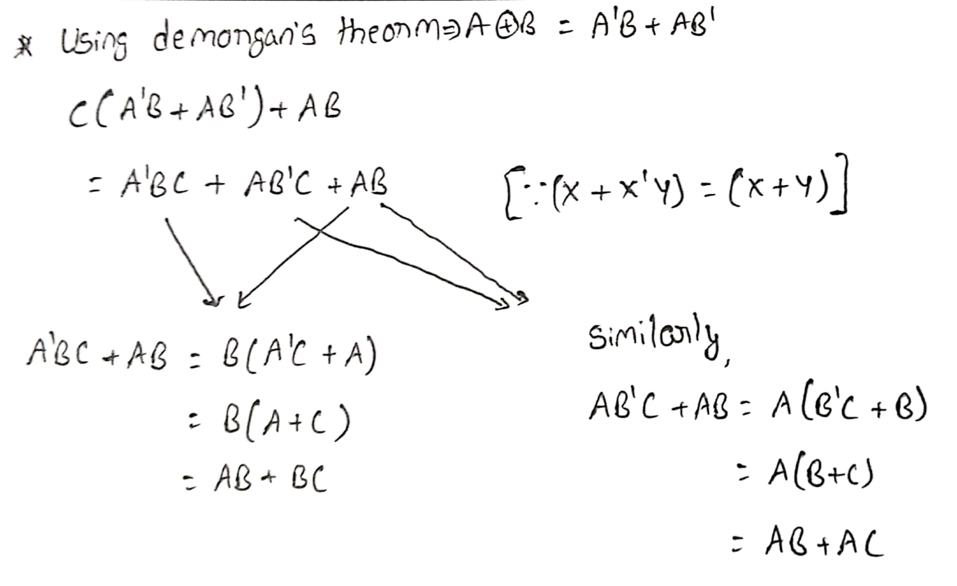
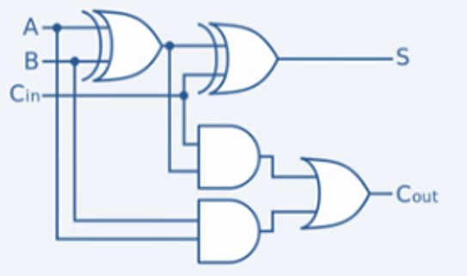
Full adder using two half adders and an OR gate
Sum is equal to the 3 input XOR using
Two 2 input XOR
Carry:

Slide 17
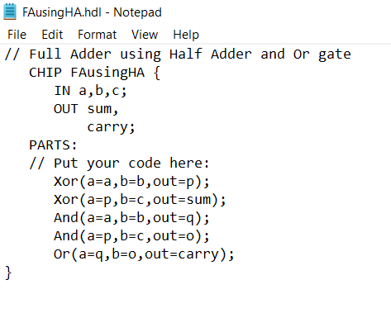
From the design we've to put the code in FAusingHA.hdl file name given in the given question.
Design:

Slide 18
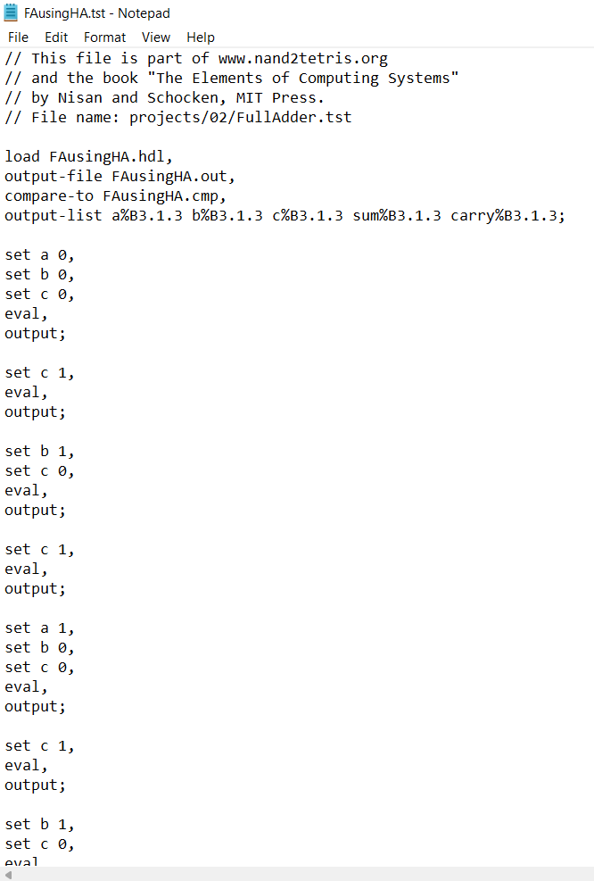
*Here we've to test the FAusingHA.hdl using Fullladder.tst file
*Before that we need to change the name of Fulllader.tst file as FAusingHA.tst because hdl and tst file name must be same name.

Slide 19
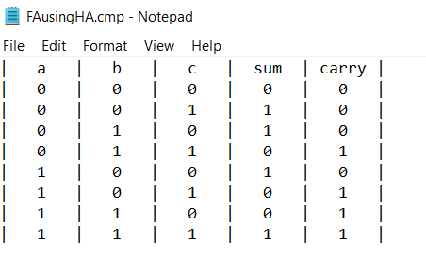
*Here we've to compare the FAusingHA.hdl using Fullladder.cmp file
*Before that we need to change the name of Fulllader.cmp file as FAusingHA.cmp because hdl and cm file name must be same
name

Slide 20
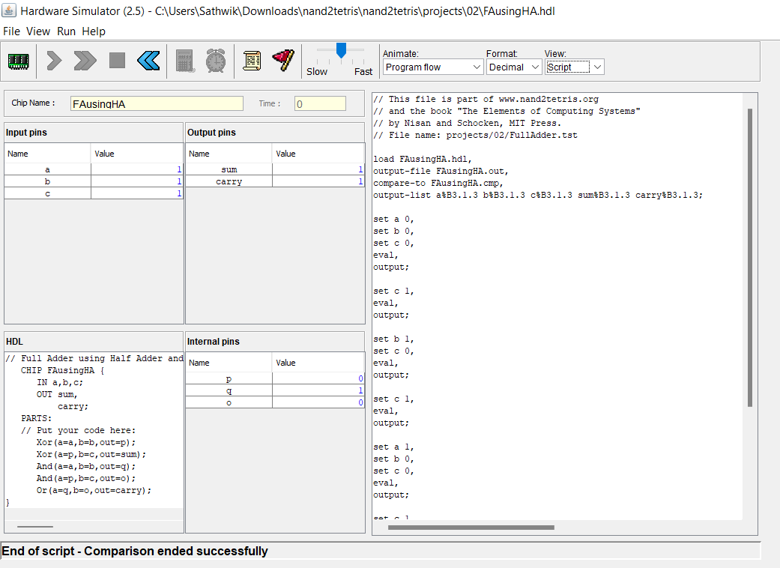
*By using Hardware simulator we've to load the FAusingHA.hdl chip
*After that we've to load the FAusingHA.tst file and run the code.
*By running the code, we are getting Comparison ended successfully.

Slide 21
3
Implement and test the following chips in the HACK platform (Use script based simulation during presentation to show the results).

Slide 22
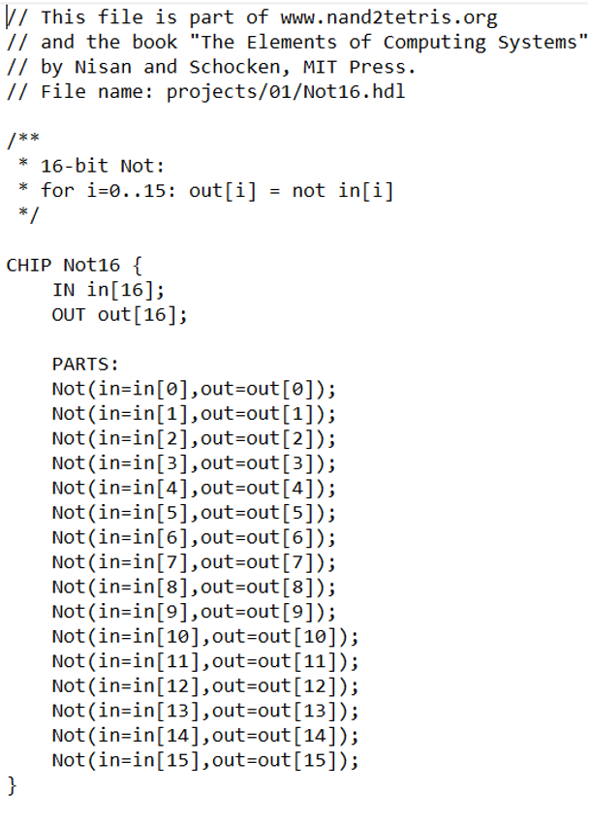
HDL FILE
(a) NOT (chip name in project folder: Not16), which is 16-bit bitwise NOT

Slide 23
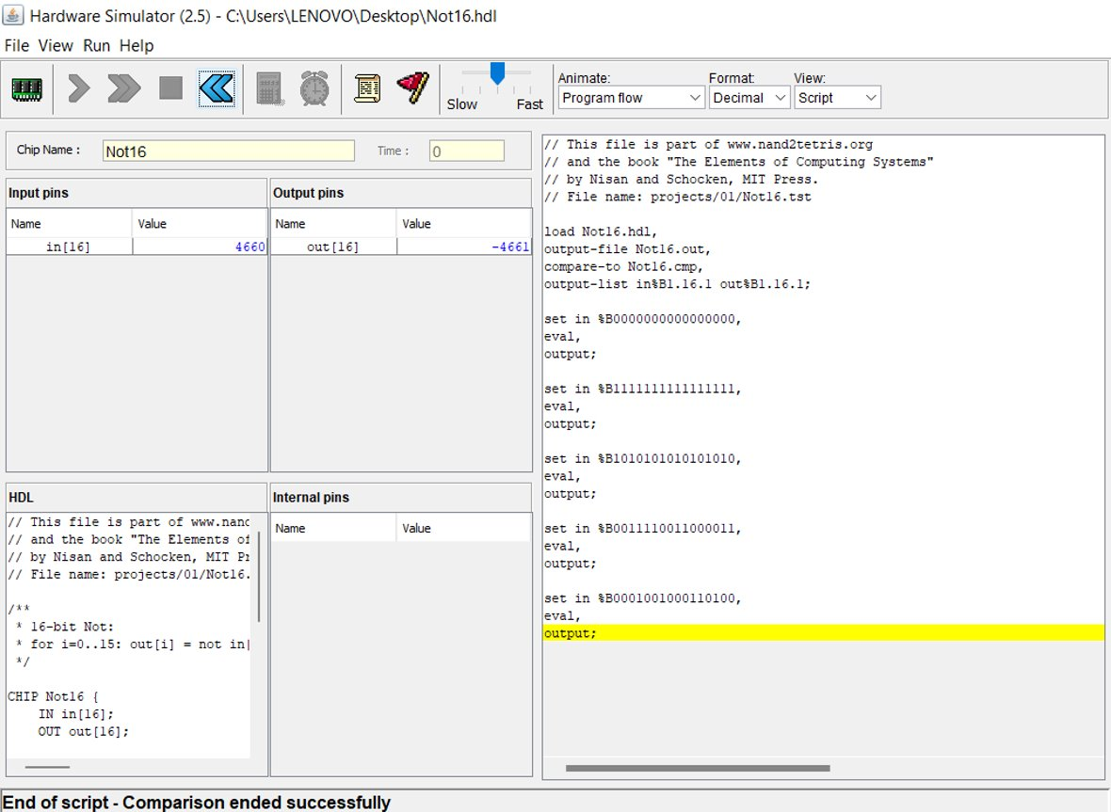
SCRIPT BASED STIMULATION

Slide 24
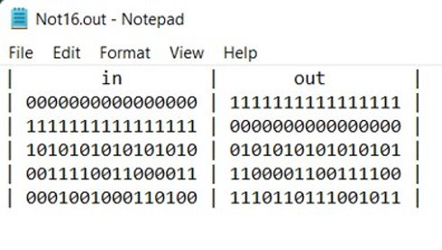
OUTPUT

Slide 25
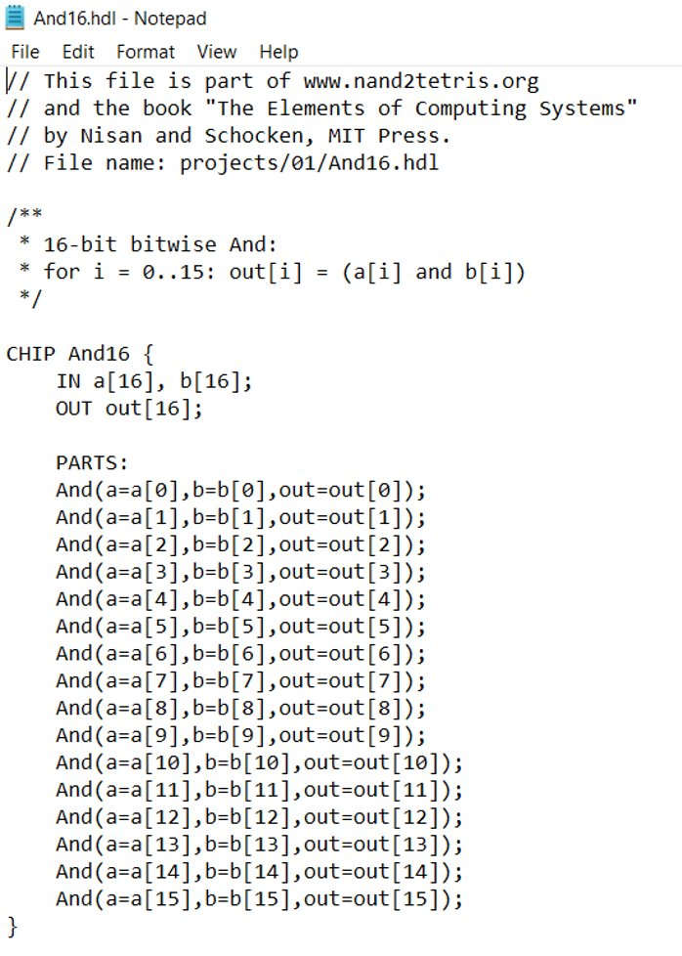
(b) AND (chip name in project folder : And16), which is 16-bit bitwise AND
HDL FILE

Slide 26
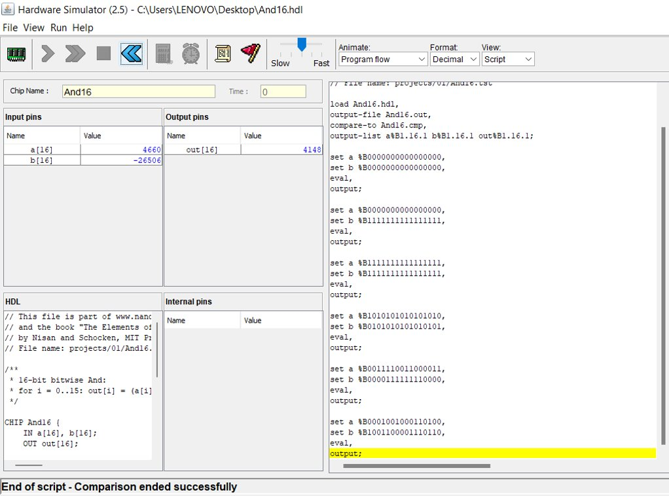
SCRIPT BASED STIMULATION

Slide 27
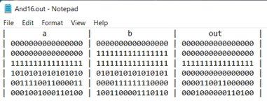
OUTPUT

Slide 28
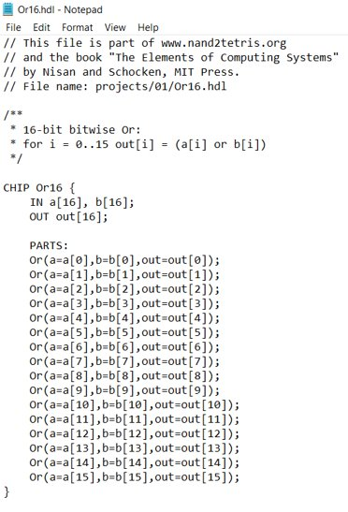
(c) OR (chip name in project folder : Or16), which is 16-bit bitwise OR
HDL FILE

Slide 29
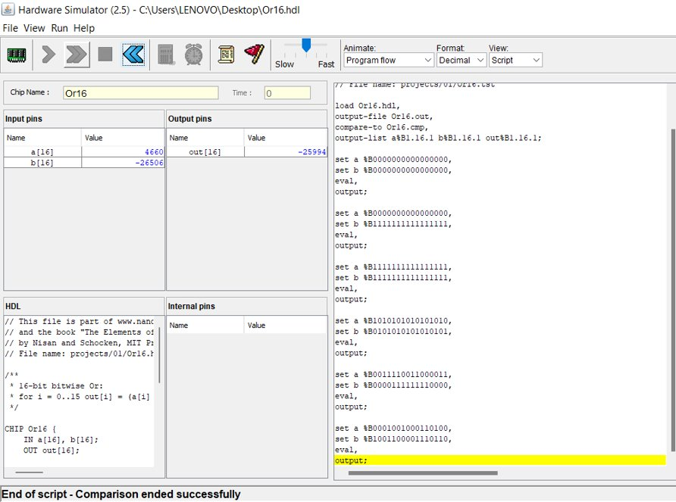
SCRIPT BASED STIMULATION

Slide 30
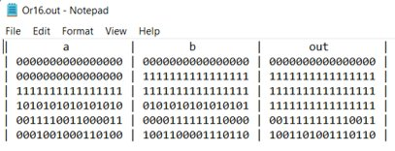
OUTPUT

Slide 31
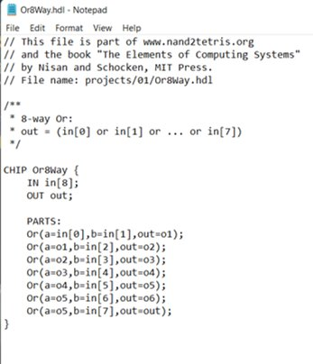
(d) Multi-way variant chip Or8way (ie, OR together all 8 bits of the input)
HDL FILE

Slide 32
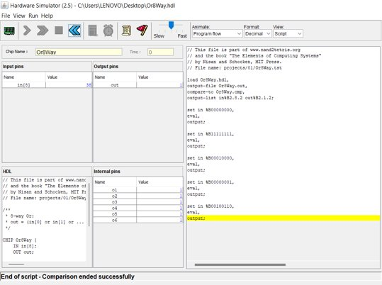
SCRIPT BASED STIMULATION

Slide 33
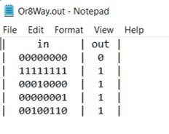
OUTPUT

Slide 34
4
Design a 16-bit parallel adder. Implement the chip logic in HDL and test the chip using hardware simulator. (The chip (Name: Add16) and supporting files are available in project folder of nand2tetris software suite. Use script based simulation during presentation to show the results).

Slide 35
Parallel Adder Design
Various designs of n-bit parallel adder
Ripple carry adder
Carry look-ahead adder
Important note :
16 bit binary parallel adder can be constructed
By using 16 full adders with input carry for LSB full adder as
zero
Or
By using 15 full adders and one half adder

Slide 36
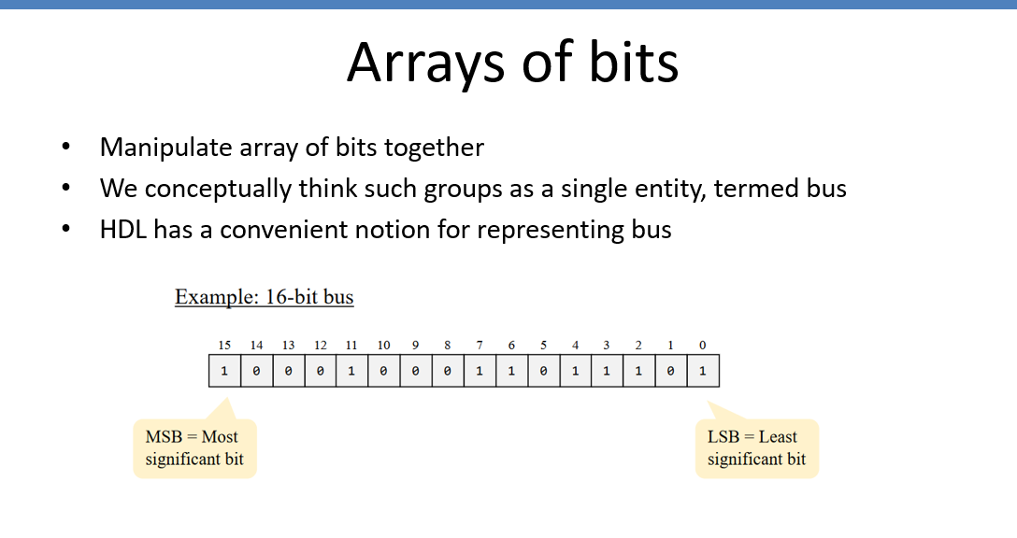

Slide 37
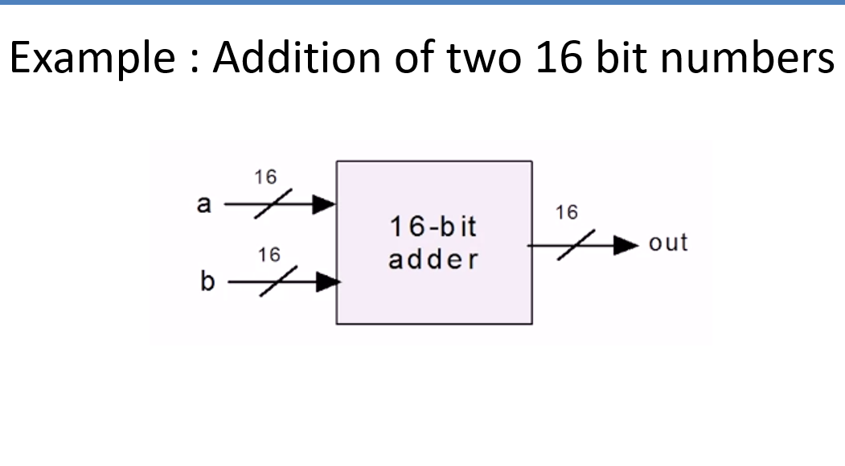

Slide 38
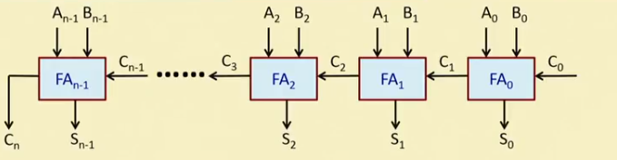
We are going to design 16 Bit Parallel Adder using 15 Full Adder
1 Half Adder
Here, n = number of bits = 16

Slide 39
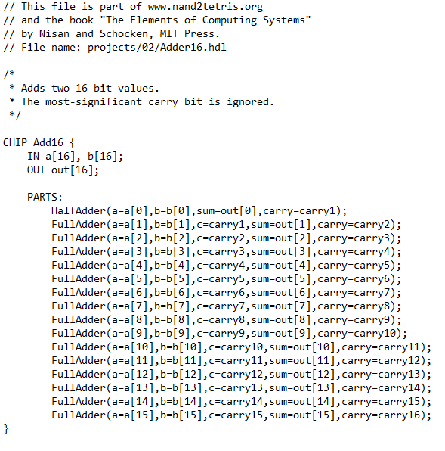
HDL CODE:-

Slide 40
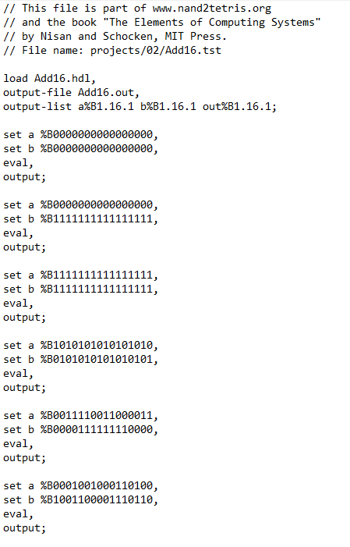
.tst file

Slide 41
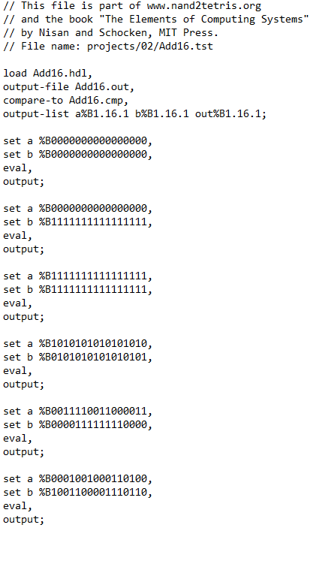
.cmp file

Slide 42
Implementation of the chip logic in HDL and testing of the chip using script based simulation in hardware simulator

Slide 43
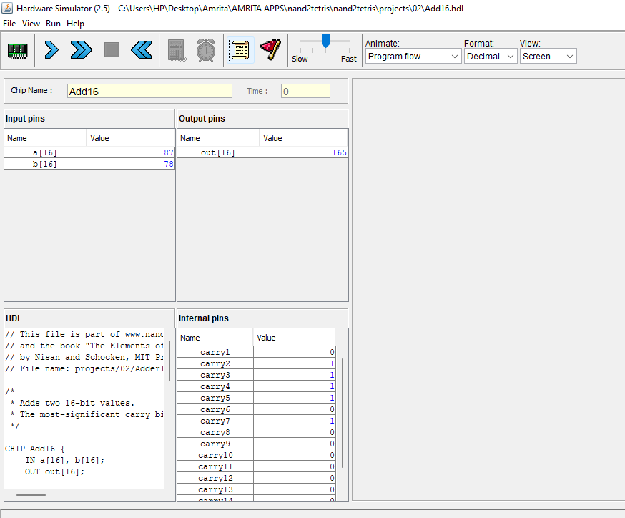
Implementation of the chip logic in HDL where we take some value of a[16] and b[16] to confirm the chip working and calculate final value and as it can be seen from the picture that we have taken decimal value of a[16]=87 and b[16]=78 which gives out[16]=165

Slide 44
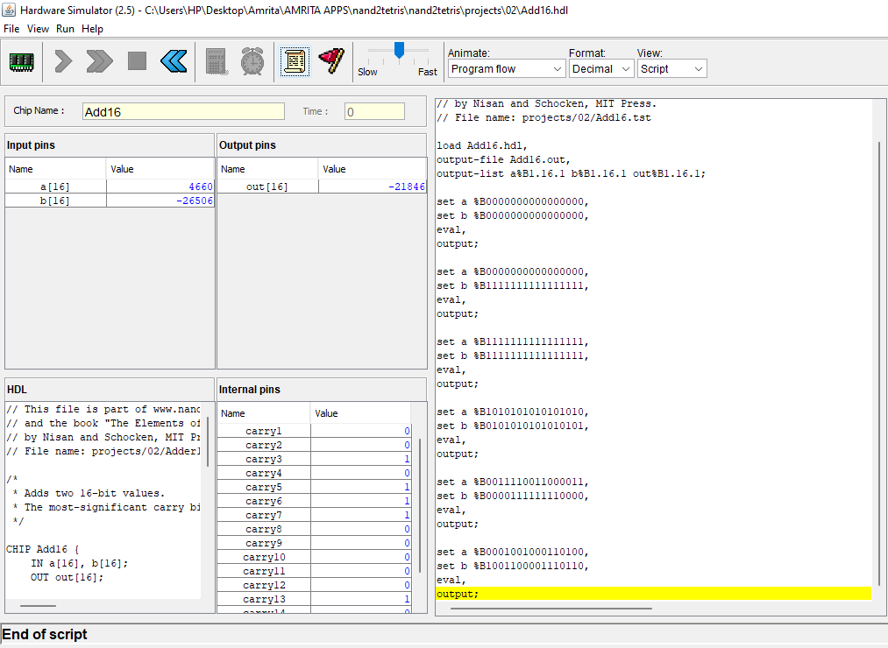
Script Based Simulation using .tst file

Slide 45
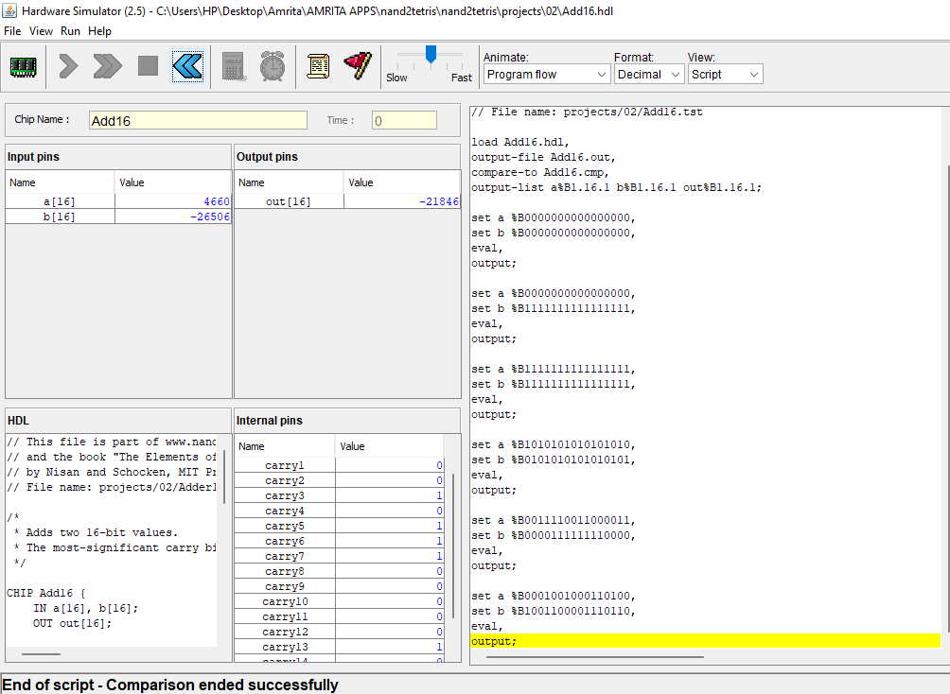
Script Based Simulation using .cmp file

Slide 46
5
Design a 4-bit Carry Look-Ahead Adder circuit without full adder . Give the CHIP name as “CarryLookAheadAdder”. Implement the chip logic in HDL and test the chip using hardware simulator ( Use interactive simulation during presentation to show the results.)

Slide 47
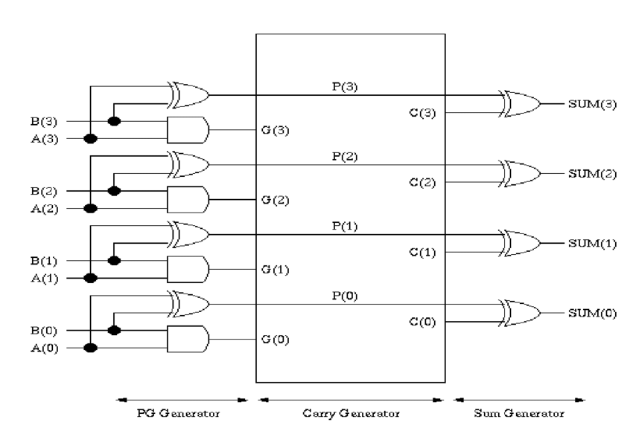
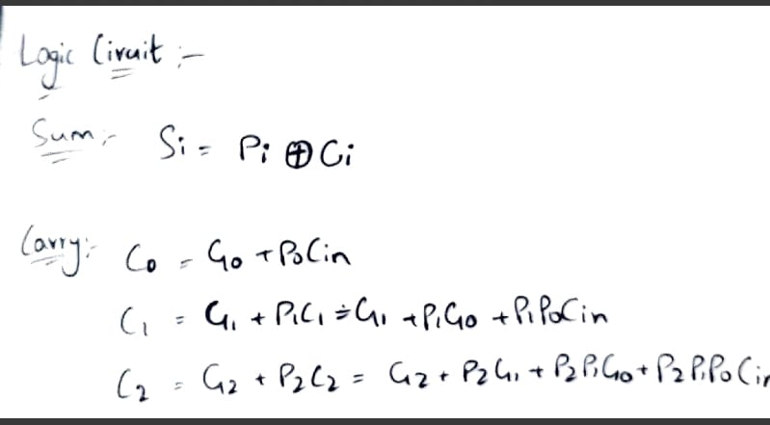
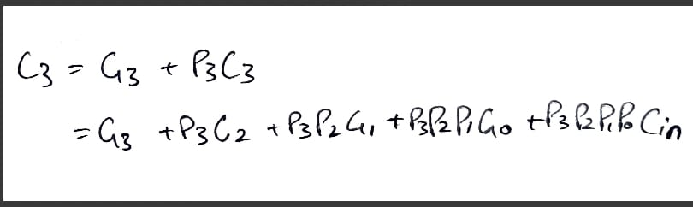
4BIT CARRYLOOKAHEADADDER:
CIRCUIT DIAGRAM:
CIRCUIT LOGIC:

Slide 48

HDL FILE:

Slide 49

Implement the chip logic in HDL and testing the chip using hardware simulator.

Slide 50

Testing the chip logic using different input values.

Slide 51
THANK YOU!

